Slide 1
The Art of Budgeting: Understanding Finances for Your Future
Jaime & Cristina Farias
Authors of The Money Funnel System

Slide 2

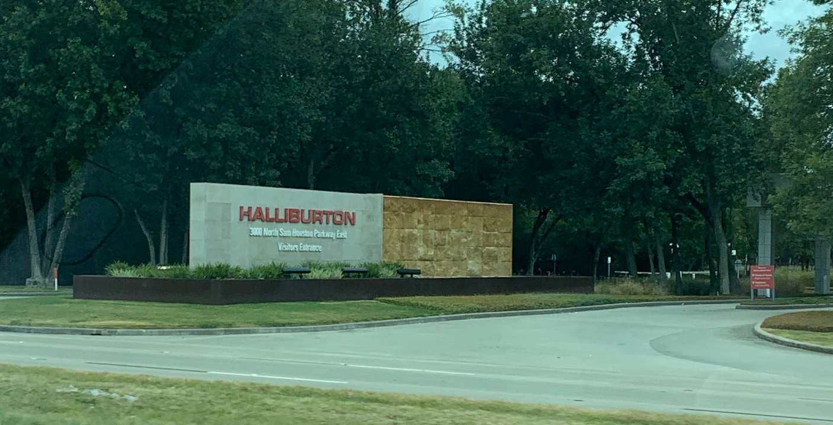



OUR STORY

Slide 3
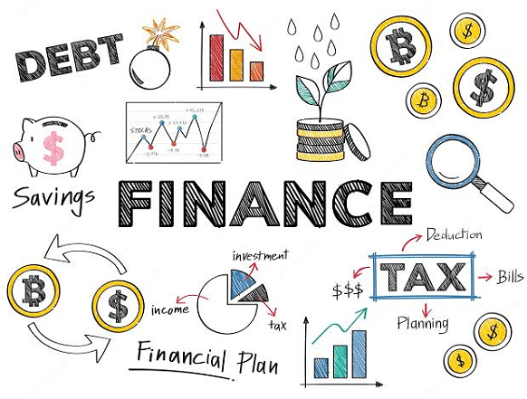
What thoughts come to mind when you hear the word “finance” or “finances”?

Slide 4

Simply put, finances
deal with how
we spend, save, and invest, the money we earn.

Slide 5


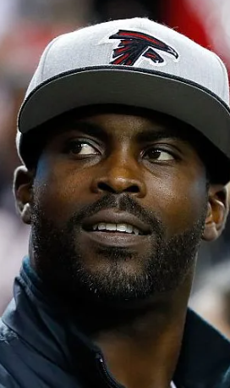

Slide 6



Slide 7
It’s not simply about how much money you make, but what you choose to do with it that matters the most.

Slide 8
Money Management
Activity

Slide 9
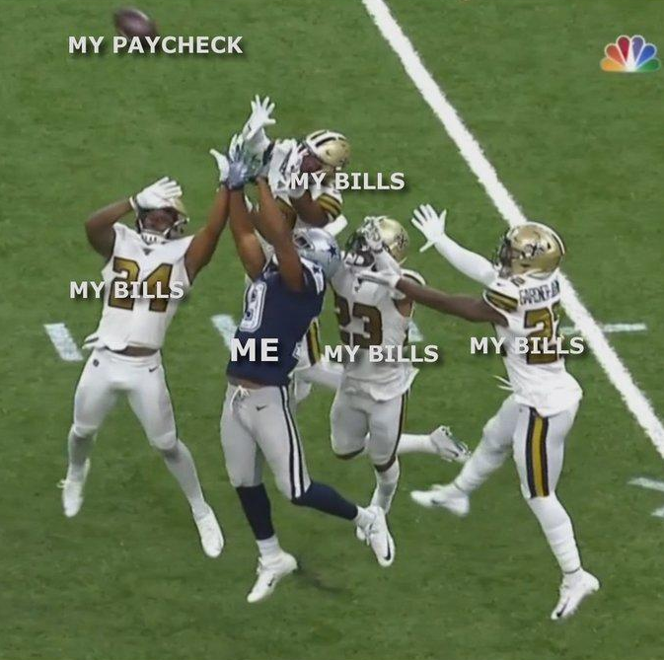

Slide 10
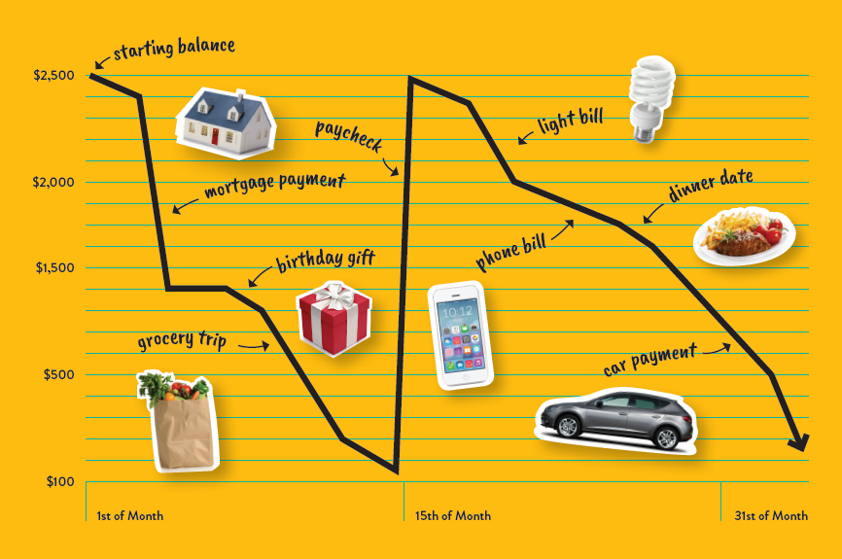
Living Paycheck to Paycheck

Slide 11

Money Tornado
Flawed visual perception
  It looks like we have more
  than what we actually do
Lack of self-control
  We see more we spend more

Slide 12
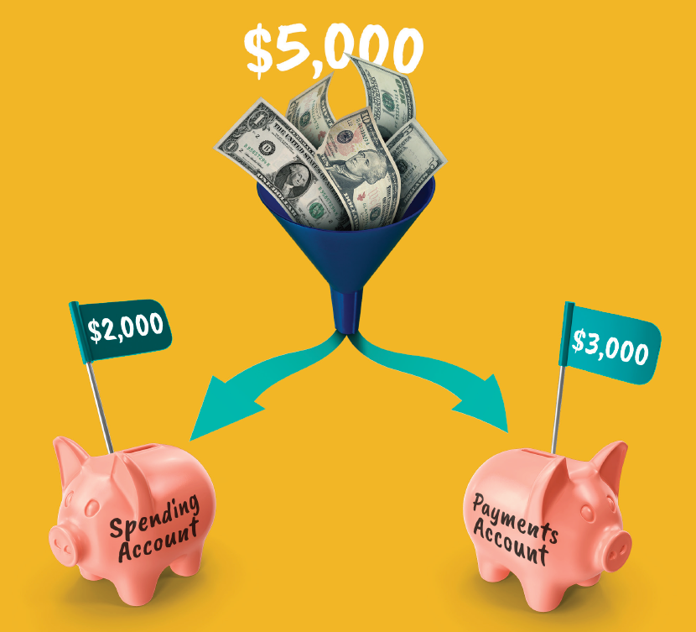
The Money Funnel System
Divide and Conquer
Determine your needs
Create a goal
Separate your money accordingly

Slide 13


Slide 14

Questions?

